Slide 1
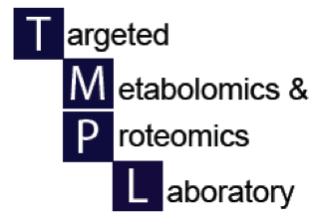
Designing a metabolomics experiment
UAB Metabolomics Workshop
December 2, 2015
Xiangqin Cui, PhD

Slide 2
Metabolomics and other -Omics
False discovery occurs in all the –omics, metabolomics is no different
Many of the non-biologic effects come from the design of the experiment
Very important to carefully consider the sources of variation and if they cannot be changed, at least ensure that their effects are evenly distributed across experimental groups
Discuss the experiment with a statistician before starting out

Slide 3
Types of Studies
To classify samples into subgroups based on profiles of metabolites
E.g., cancer subtypes
Looking for metabolite signatures that are associated with a disease/condition
E.g., diseased vs controls; treated mice with control mice
Study mechanisms of certain disease/condition at metabolite level
E.g., drug effect mechanism

Slide 4
Design Considerations for Different Types of Metabolomics Studies
Classification studies
relatively larger sample size
No replicates
Training set vs testing set
Comparing disease/treatment vs control for different metabolite profiles
Comparison groups
Sample size in each group
Can we pool samples?

Slide 5
Design Considerations for All Metabolomics Studies
Biological and Technical variability
Balancing (Blocking)
Randomization

Slide 6
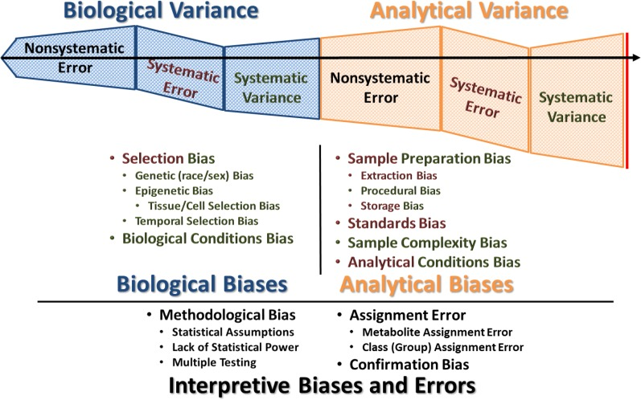

Slide 7
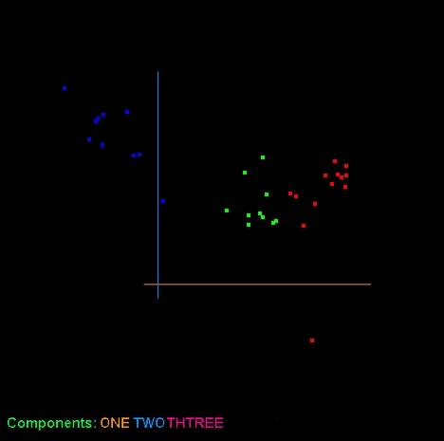
UMSA Analysis
Day 1
Day 2
Insulin Resistant
Insulin Sensitive

Slide 8
How to Solve This Problem?
Process all samples in the same day.
Process half sensitive samples and half resistant samples in each day (balance sample groups against days– “treat each day as a block” in statistical terms).

Slide 9
Known sources of non-biological biases (not exhaustive) that must be addressed
Technician / post-doc
Reagent lot
Temperature
Protocol
Date
Location
Cage/ Field positions

Slide 10
Too Many factors to balance? -- Randomize
Number the objects to be randomized and then randomly draw the numbers.
Example: Assign two treatments, Special Diet and control, to 6 mice
1 2 3 4 5 6
Special Diet : (1,3,4)
Control : (2,5,6)

Slide 11
Randomization in Metabolomics Experiments
Randomize samples in respect to treatments
Randomize the order of handling samples.
Randomize batches/runs/days in respect to samples
Randomize over any other variable procedures.

Slide 12
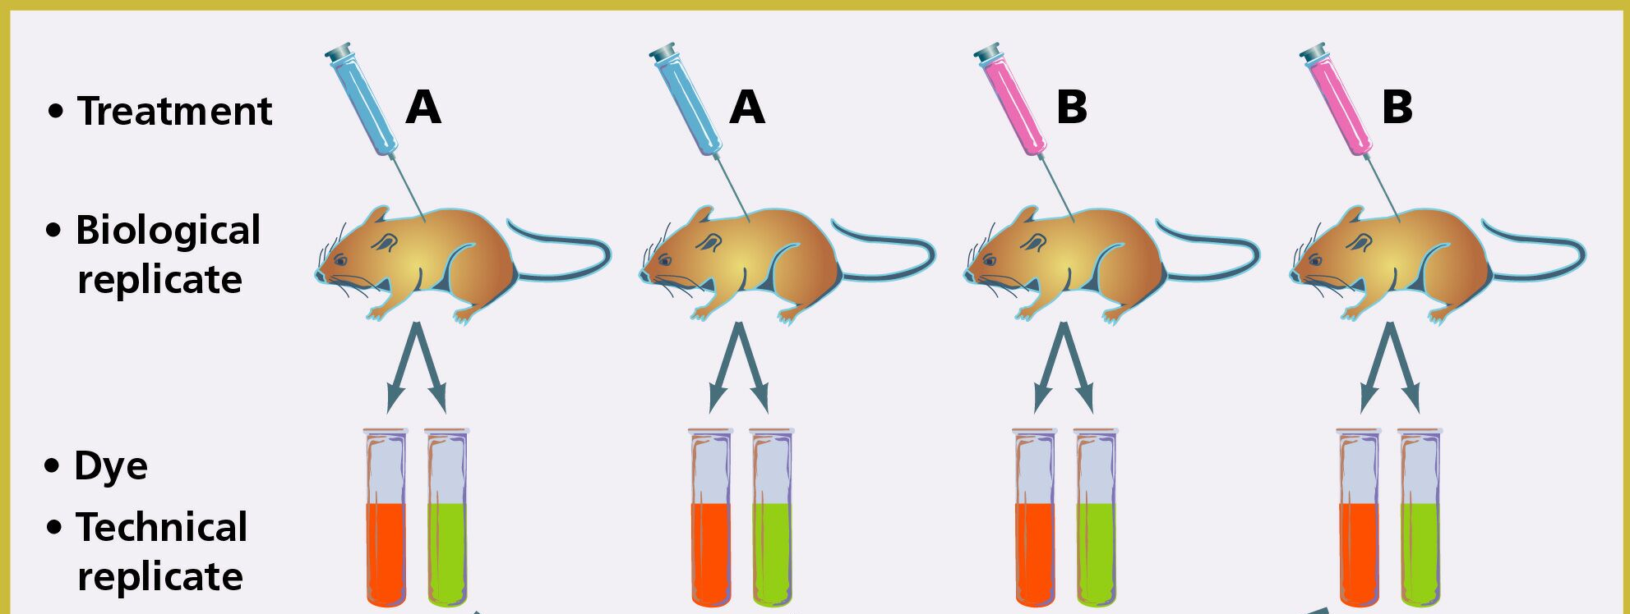
Replication and Sample Size for Identifying Differential Metabolites
Replications should not be confused with repeated measurements.

Slide 13
How Many to Replicate? ---Sample Size
Depends on $$
Variability -- Variability increases, N increases.
Difference to be detected– Difference increases, N decreases.
Desired Power – Power increases, N increases.
Significance level– Significance level increases, N increases.

Slide 14
Can I pool my treatment samples?
It is rarely recommended unless it is necessary, e.g., working with fruit flies.
It has potential benefits (reduce biological variability) and drawbacks (lack of measure of variability across individuals).
Definitely not pooling all your treatment samples into one big pool and your control samples into one big pool.

